Slide 1
Using Azure DevOps for Sprint Planning: This video may be helpful, but we are not doing all the things described.
https://youtu.be/SbFKi6Hflc0

Slide 2
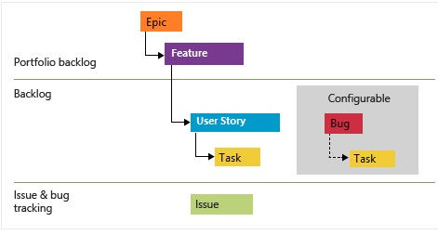
https://docs.microsoft.com/en-us/azure/devops/boards/work-items/guidance/choose-process?view=azure-devops
The tool supports various flavors of Agile processes
We are not going to use Epics (good for planning customer visible Versions, e.g. V1, V2, etc
We will use Features, User Stories, and Tasks. You should use Bugs too.
We won’t use the Issues
Next 3 slides jump ahead to the end point to give you idea where we are going.

Slide 3
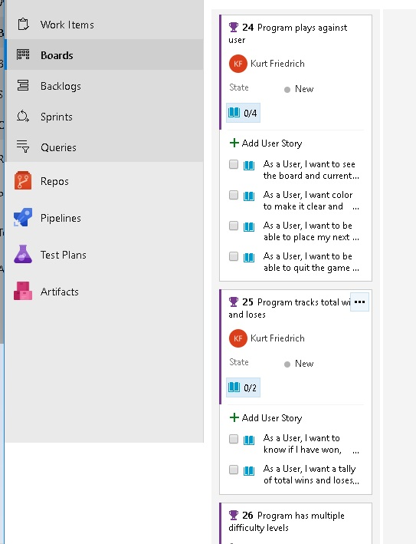
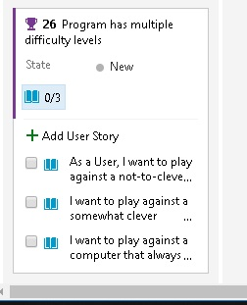
All 3 Features and all their user
stories are entered.
Now break the User Stories down
Into Tasks

Slide 4
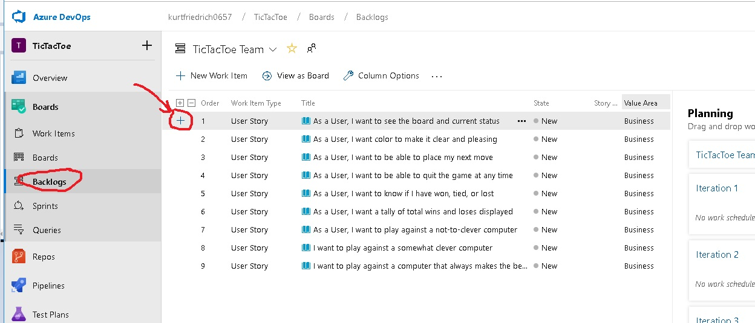
Now click the “+” for each user story and break it done into coding Tasks

Slide 5
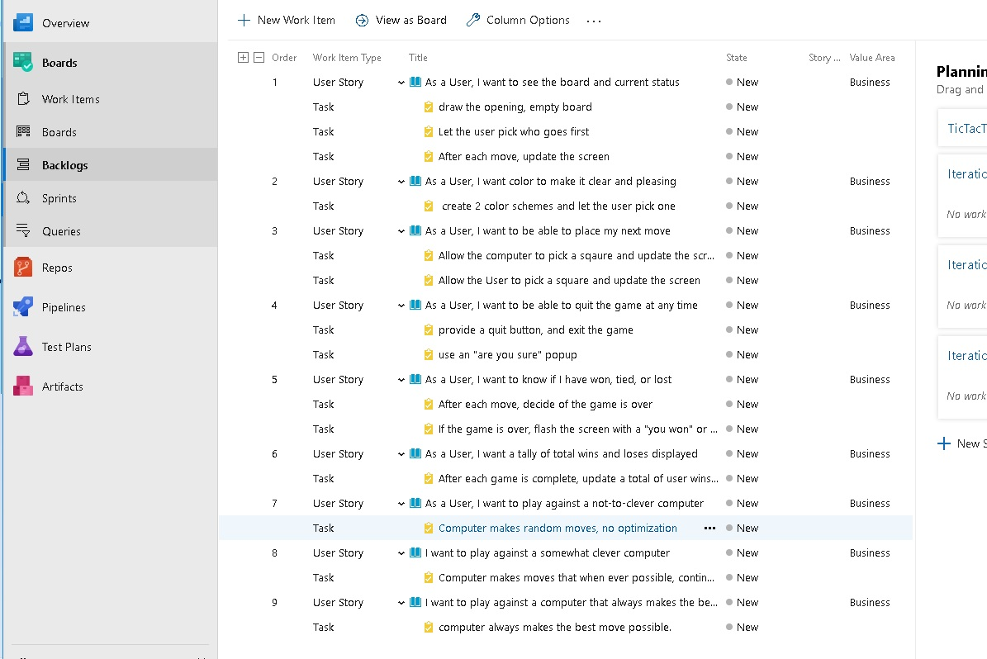

Slide 6
One member needs to create an Azure DevOps account, and add the other team members and me (kurtfriedrich@hotmail.com)
Make sure as you add the team members, they are added as “Contributors” (see next slides)

Slide 7
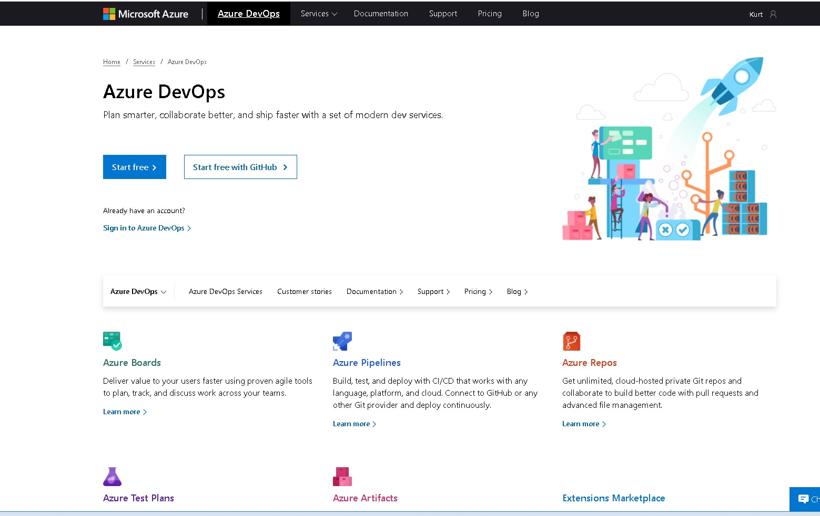
https://azure.microsoft.com/en-us/services/devops/?nav=min

Slide 8
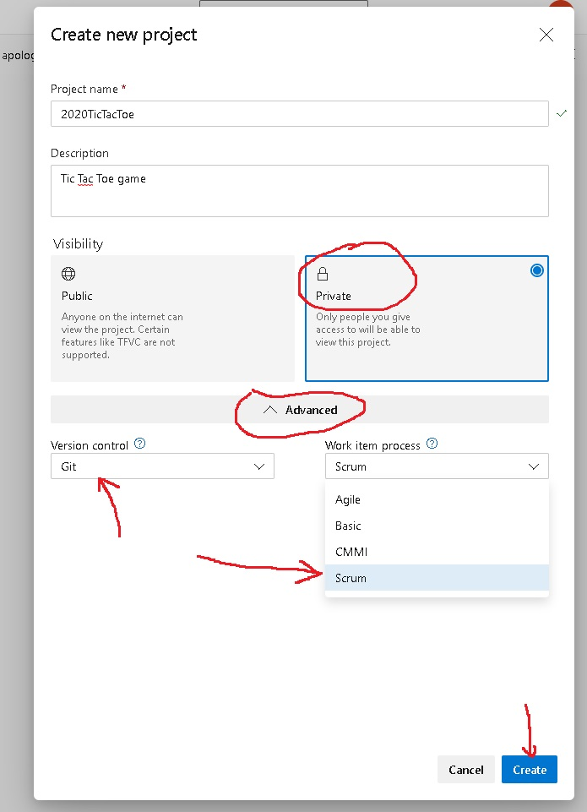
Click the Advanced,
Select Git and Scrum

Slide 9
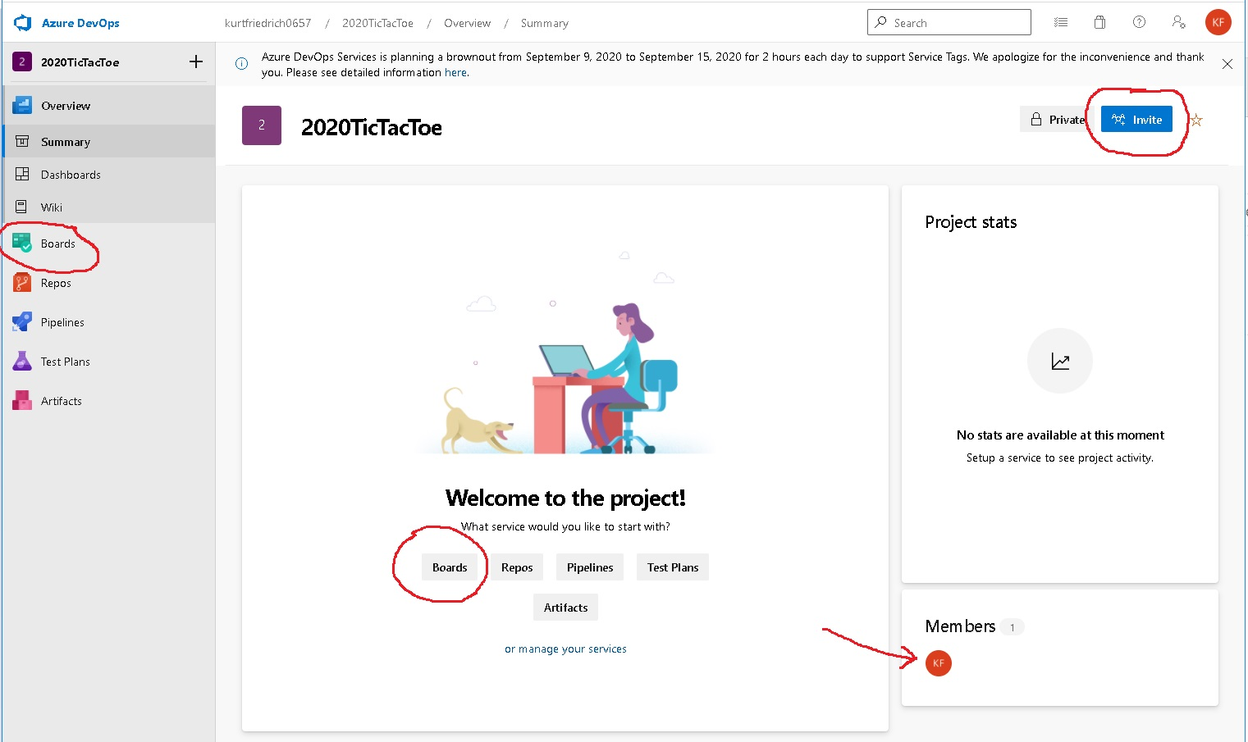
Invite other team members.
We are only using the Boards part of DevOps

Slide 10
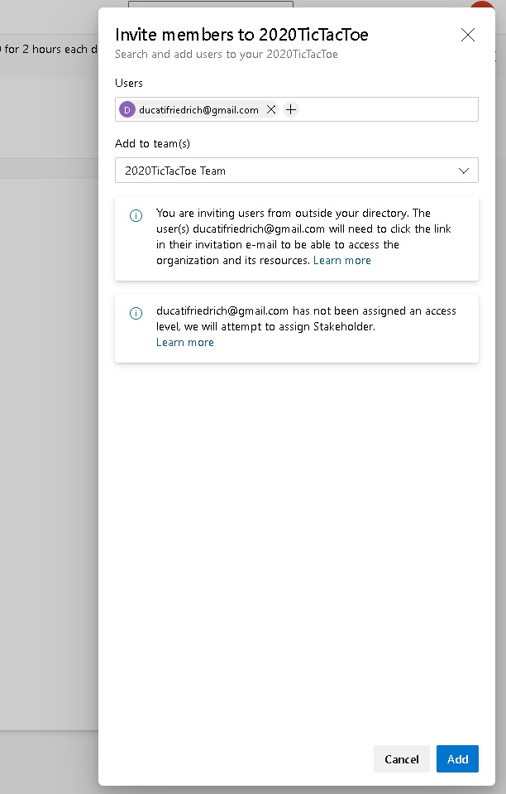
Add each member of your team’s
Email account. Make sure you use
the email account associated with their Azure account, which should almost certainly be their BC mail account.

Slide 11
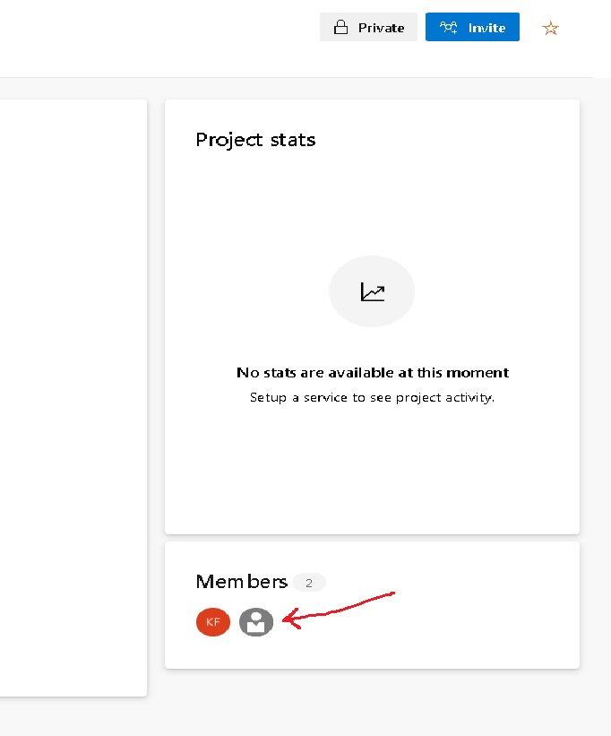
A success box briefly appeared over here.
At this point, they are just members, with no rights

Slide 12
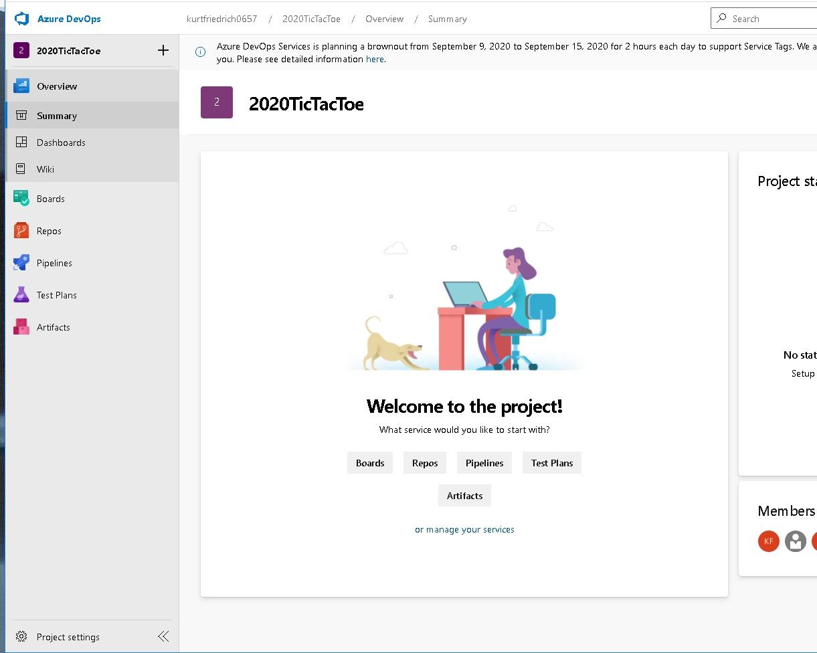

Slide 13
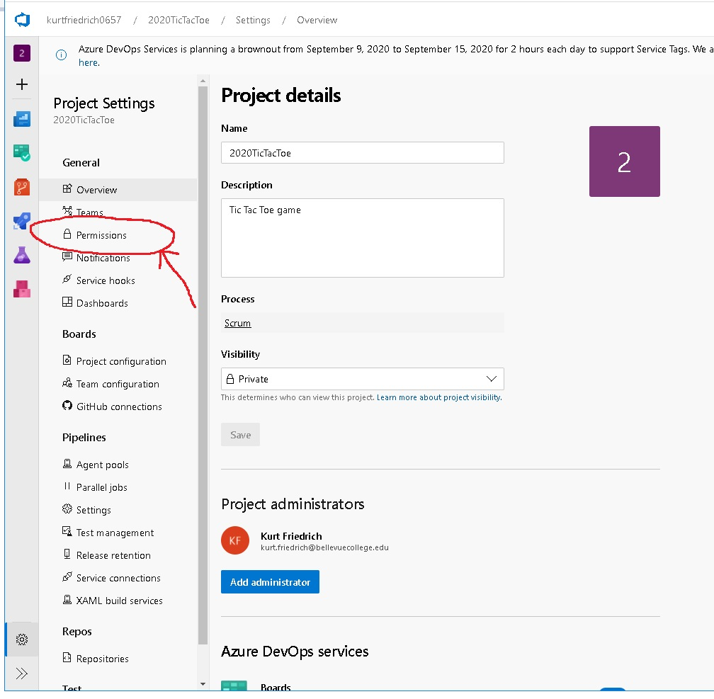

Slide 14
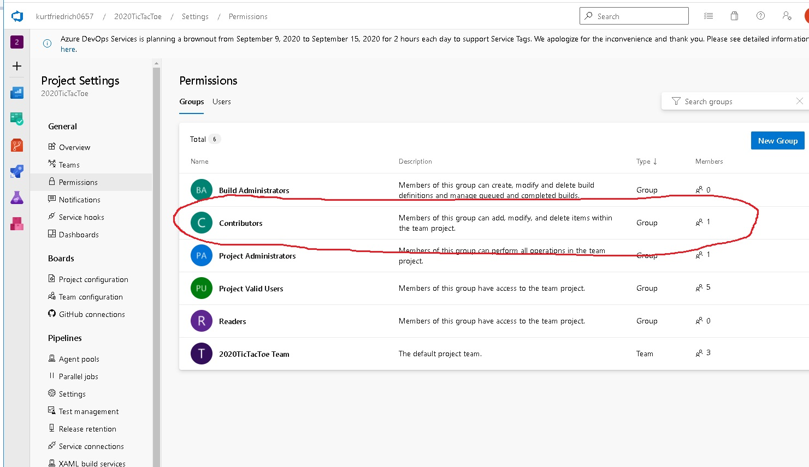

Slide 15
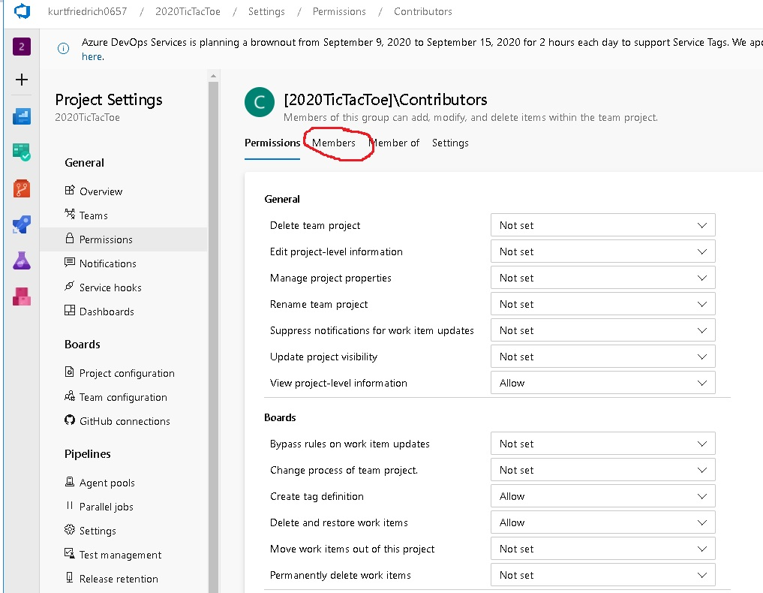

Slide 16
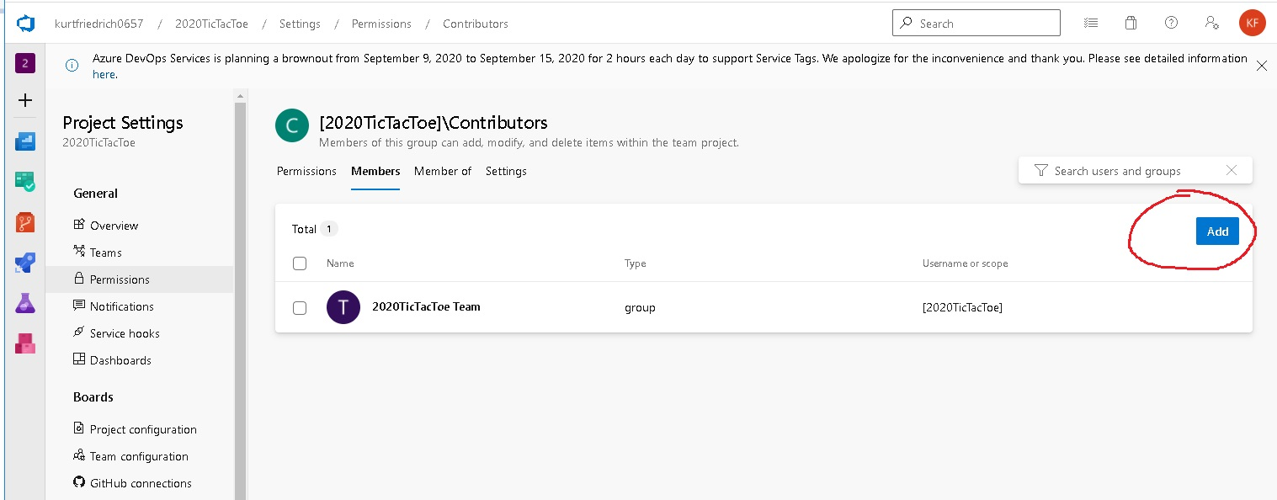

Slide 17
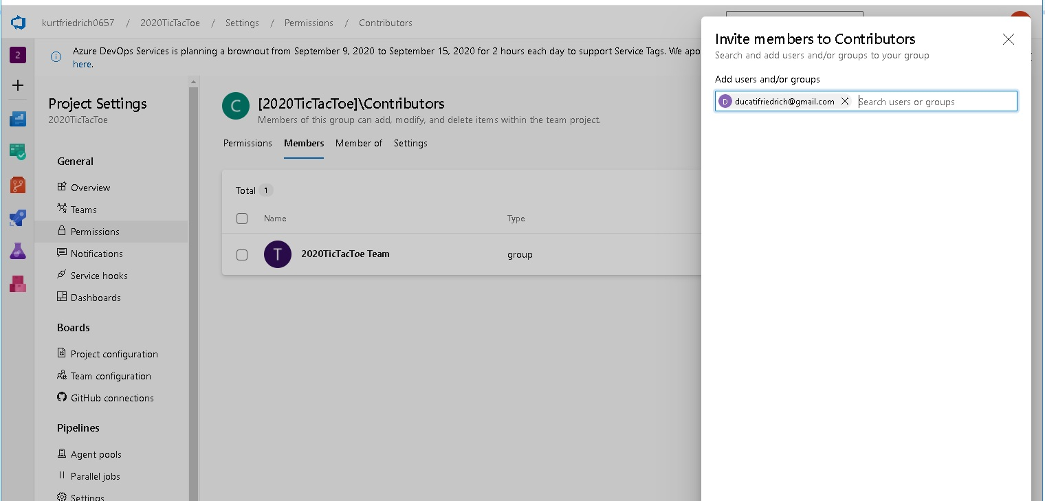
Now they are members of both the project, and the subset group of “Contributors”

Slide 18
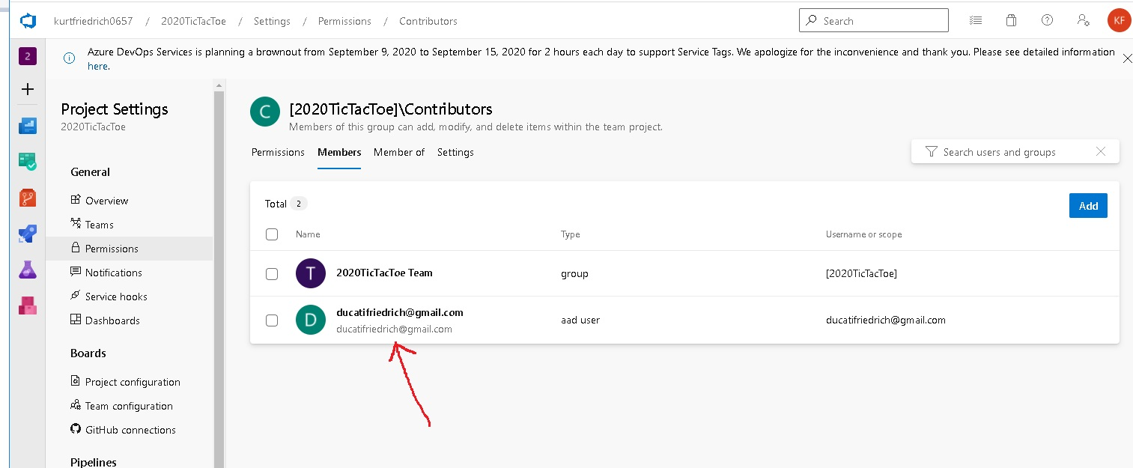

Slide 19
This page accidentally left blank

